Slide 1

Olympics
Olympics from ancient Greek times to modem times

Slide 2
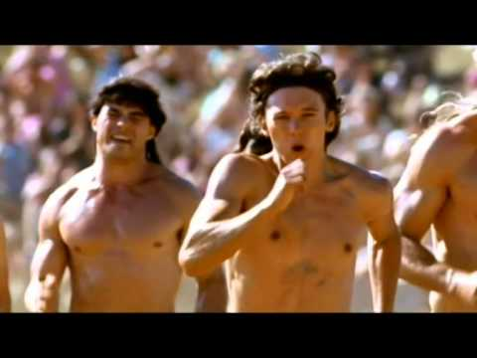
The Greeks loved sport and the Olympic Games were the biggest sporting event in the ancient calendar.
The Olympic Games began over 2,700 years ago in Olympia, in south west Greece. Every four years , around 50,000 people came from all over the Greek world to watch and take part. The ancient games were also a religious festival, held in honour of Zeus , the king of the gods.
There were no gold, silver and bronze medals. Winners were given a wreath of leaves and a hero's welcome back home. Athletes competed for the glory of their city and winners were seen as being touched by the gods
The modern Olympic Games or Olympics are leading international sporting events featuring summer and winter sports competitions in which thousands of athletes from around the world participate in a variety of competitions

Slide 3
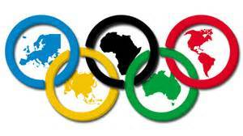
Friday, 23 July 2021
and ends on
Sunday, 8 August
Modern Olympic
The modern Olympic Games or Olympics (French: Jeux Olympique's) are leading international sporting events featuring summer and winter sports competitions in which thousands of athletes from around the world participate in a variety of competitions.

Slide 4
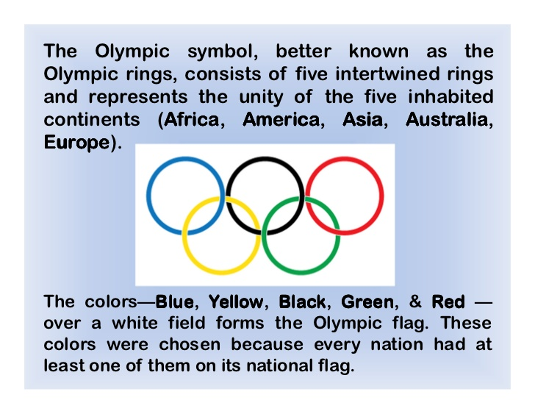

colours

